Slide 1
Sacramento Real Estate: Finding Average
Shawn Cavazos, Edward Michaud, Amara Hamadache
5/08/2021

Slide 2

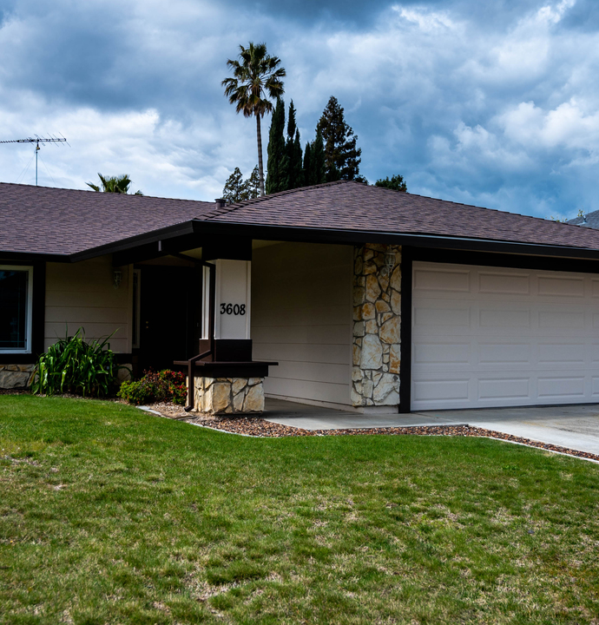
The Scenario:

Slide 3
How do we satisfy the request?
Locate and clean the Data
What are the common metrics for the average home purchase
Create bins of data to represent common breakpoints
Create visual aides to guide our home buyer
Identify current trends in the market
Identify/Eliminate outliers
Using median or mean?

Slide 4
Overall Game plan
First, Locate and clean the data
Next, we analyze the data and create practical depictions
Finally, our conclusions are presented to the client

Slide 5
Initial setup:
Our first step in this project was to clean up all the data.
We had to make sure there were no empty slots or strange discrepancies.
We then cleaned it up to make sure there are no repeated locations or if the location had no square feet.
We made sure that the data was clean with a few tests, and all checked out.

Slide 6
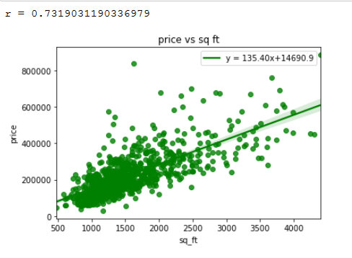
Making the Scatter plot graph:
A graph relating square foot to its price was first created.
This shows how more people would select around the 1000-2000 square foot mark and pay around $150,000-$250,000 range.
It becomes less popular to buy housing that are above $400,000
This chart is not conclusive but does give us a reference point going forward

Slide 7
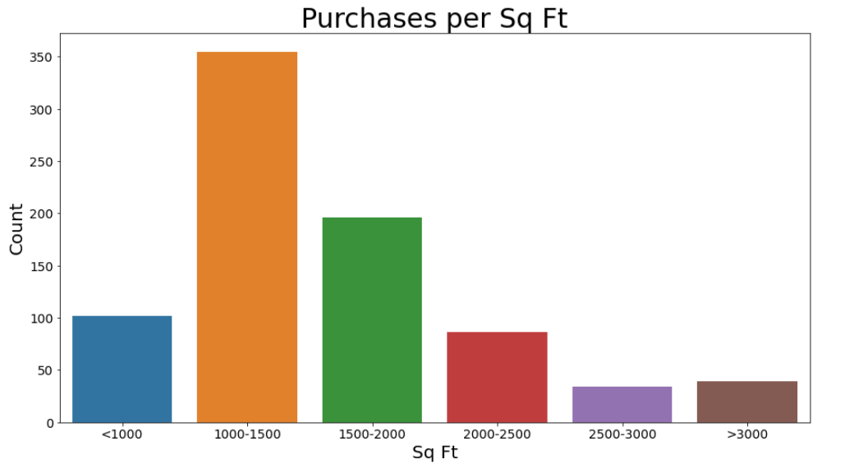
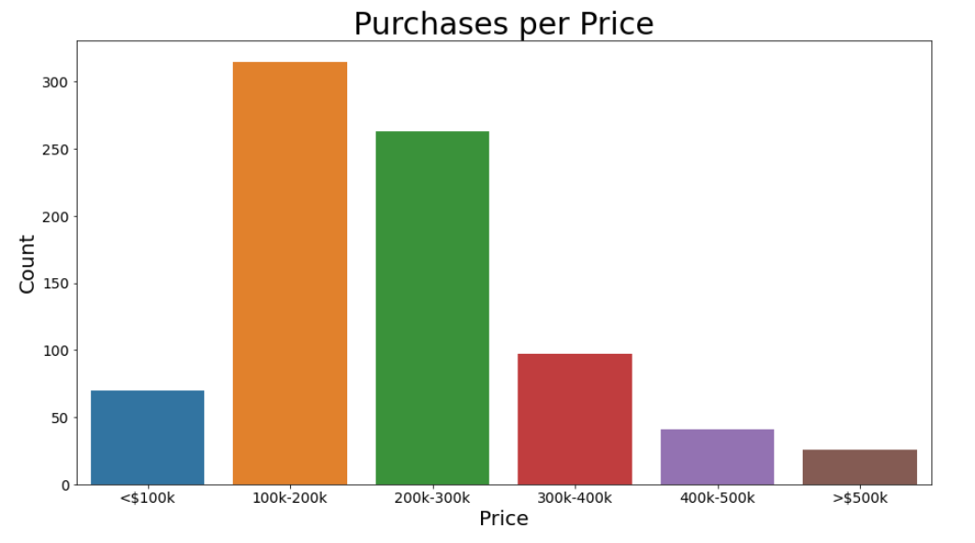
Making a bar graph
Information about how many purchases were made Per square foot.
A bar graph was used to depict the occurrences of purchase of houses and their price range.
Another bar graph was made for bedroom count.

Slide 8
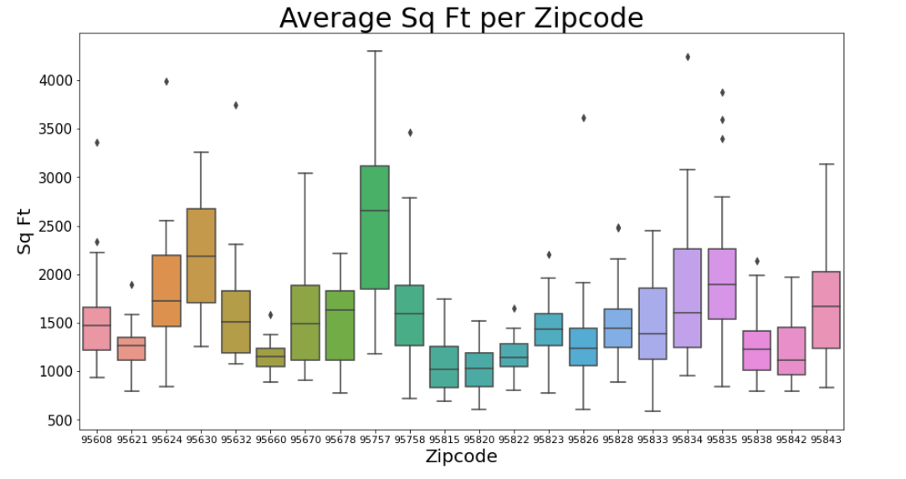
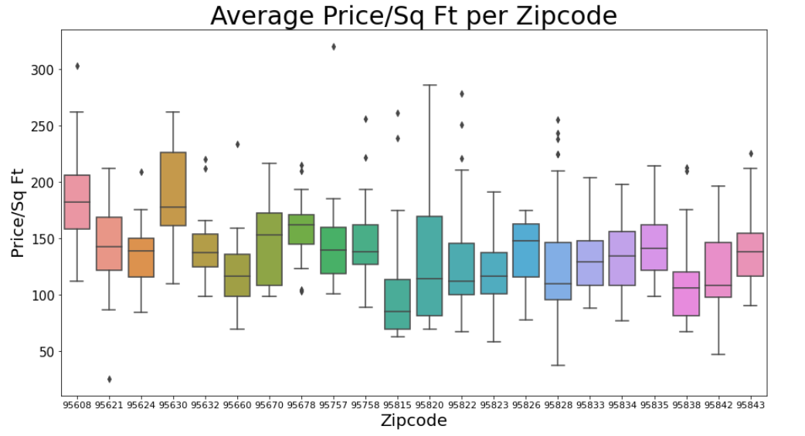
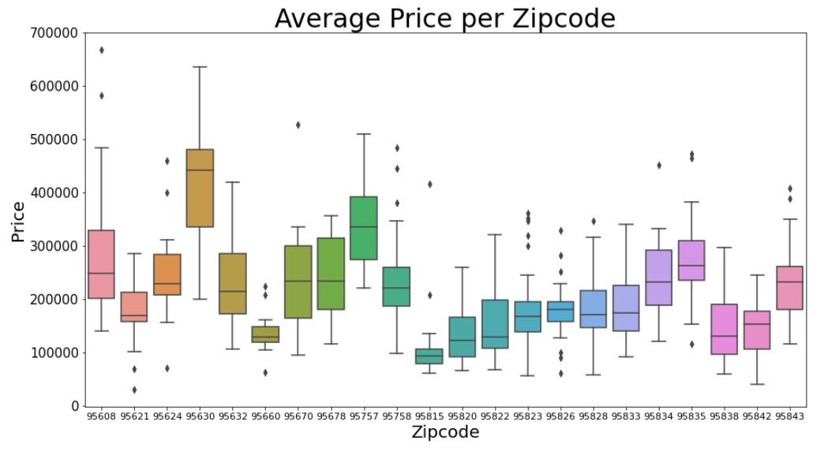
Making a box PLOT
A box plot was used to find variation between zip codes.
One was made for average price, another for average square foot, and average price per square foot.

Slide 9
Box Plot Analysis
Box plots helped depict the variance of different zip codes
In order to eliminate outliers, only zip codes with 12 or more datapoints were used.

Slide 10
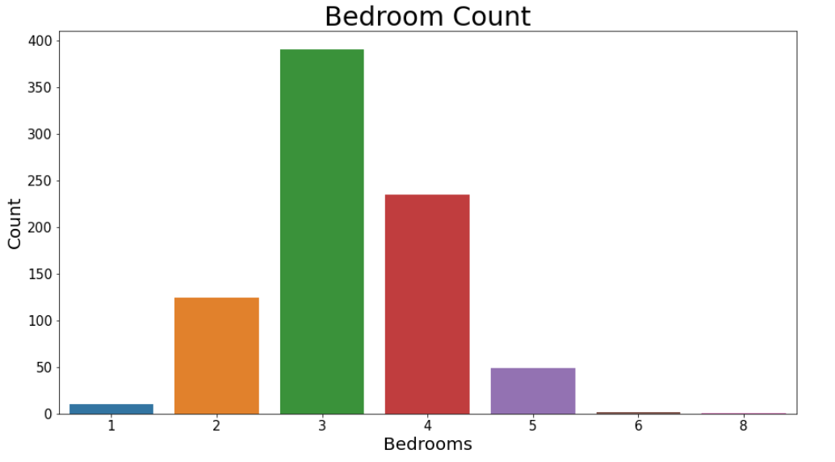
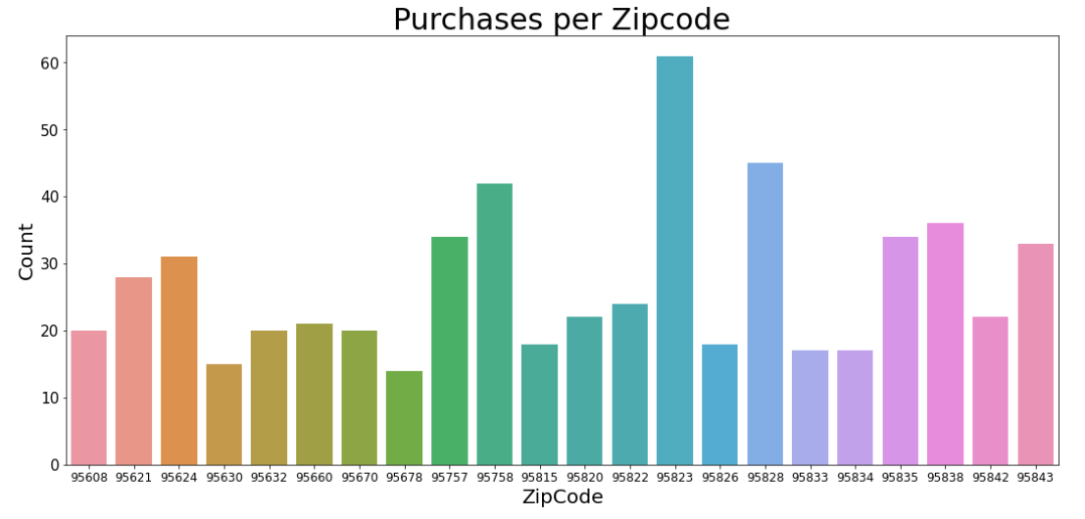
Bar graphs
Bedroom count:
3-bedroom houses are the most purchased
followed by 4-bedroom
Purchases per zip code
The most purchases were made In the zip code 95823

Slide 11
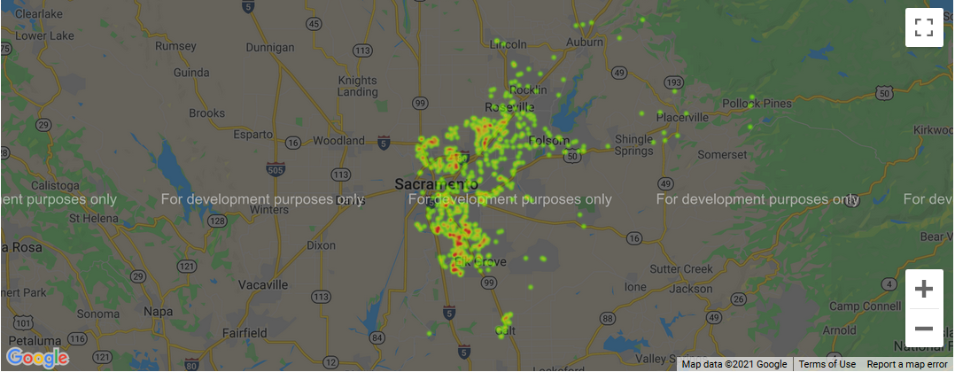
Heat Map This heatmap shows where in Sacramento are most of the purchases were being made

Slide 12
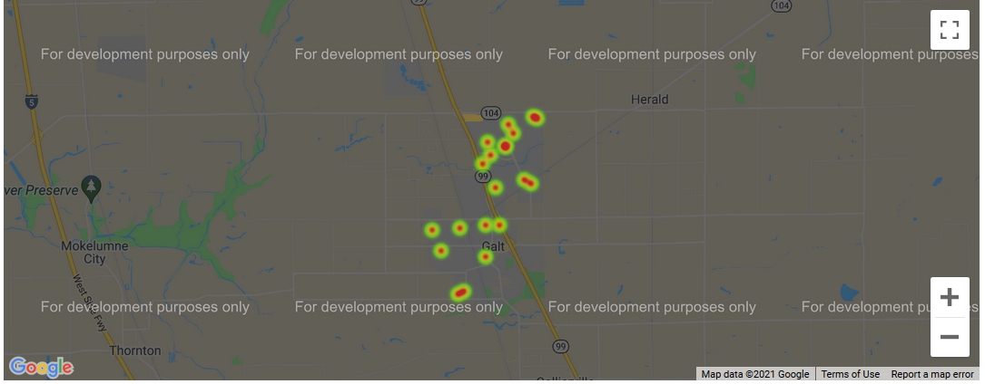
Heat Map This heatmap shows the location of the houses in the average zip code which is 95632

Slide 13
Conclusion:
Our client can choose around the average houses which is:
$ 214,000
1500 sq ft
3 bedrooms
the most popular zip code 95823
the most average zip code 95632

Slide 14

Summary and Questions

Slide 15
Sources
https://support.spatialkey.com/spatialkey-sample-csv-data/
https://support.spatialkey.com/spatialkey-sample-csv-data/
https://account.sacbee.com/paywall/subscriber-only?resume=250652634

